Slide 1
DS-306 Data Warehousing and Business Intelligence
Topic 6: OLAP and Its Operations
Dr. Khurram Shahzad

Slide 2
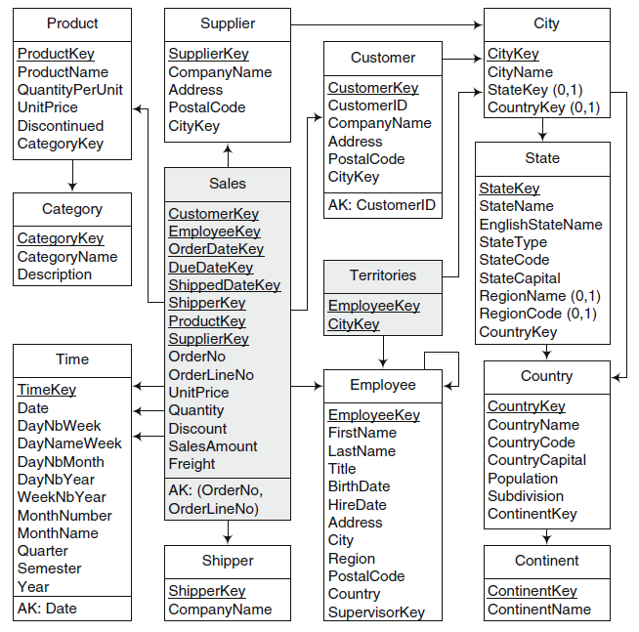

Slide 3
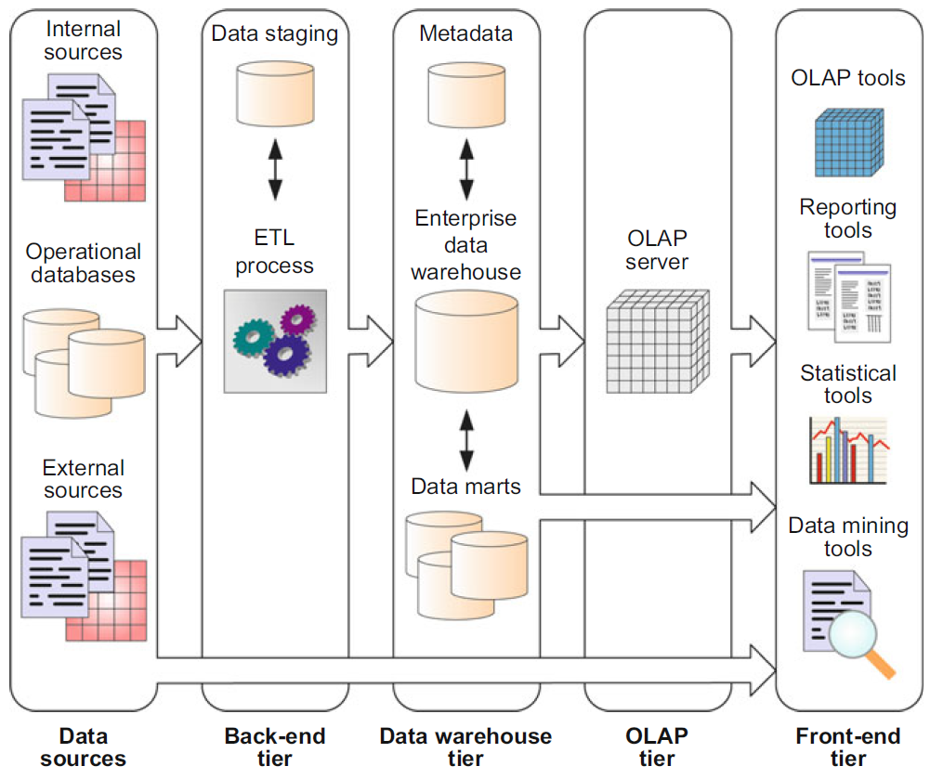
Typical DW architecture

Slide 4
Typical DW architecture

Slide 5
Supporting the human thought process
THOUGHT PROCESS
QUERY SEQUENCE
An enterprise wide fall in profit
What was the quarterly sales during last year ??

?
Profit down by a large percentage consistently during last quarter only. Rest is OK
What was the quarterly sales at regional level during last year ??
What was the quarterly sales at product level during last year?
What is special about last quarter ?
What was the monthly sale for last quarter group by products
Products alone doing OK, but North region is most problematic.
What was the monthly sale for last quarter group by region
OK. So the problem is the high cost of products purchased
in north.
What was the monthly sale of products in north at store level group by products purchased
How many such query sequences can be programmed in advance?

Slide 6
Observations on Example
Analysis is Ad-hoc
Analysis is interactive (User-Driven)
Analysis is iterative
  Answer to one question leads to a dozen more
Analysis is directional
  Aggregating to lower level in dimensional hierarchy
  Aggregating to higher level in dimensional hierarchy
  Including multiple dimensions

Slide 7
Observations on Example
Writing pre-defined queries will not work
  Does not remain user-driven
  Does not remain Ad-hoc and hence is not interactive
Enable Ad-hoc query support
  User can build his/her own queries (No SQL)
  Do not afford on-the-fly computation
Problem
  Want to Pre-compute the answers but do not know the questions
Solution
  Compute answers to all possible questions
  Remember, questions are always multidimensional aggregations at some level

Slide 8
OLAP Solution
Online Analytical processing system
  Online = no waiting for answer
DW stores data and OLAP is for analysis of data and facilitates analysis
OLAP: “A category of applications and technologies for collecting, managing, processing and presenting multidimensional data for analysis and management purposes”

Slide 9
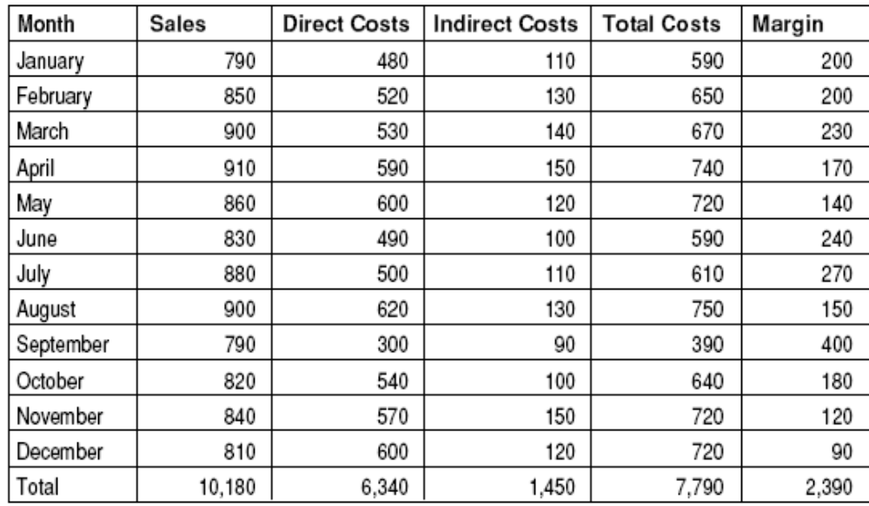
Two dimensions/Traditional Analysis
Example of two dimensions can be represented by a table

Slide 10
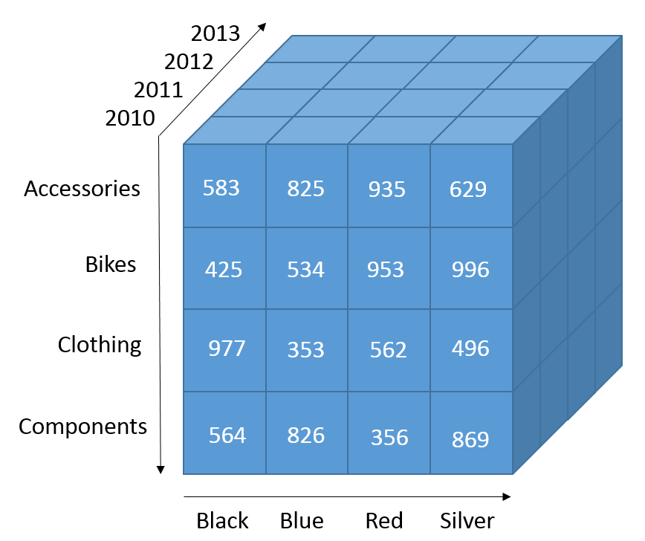
Three-dimensional Cube
Three dimensions visualization

Slide 11
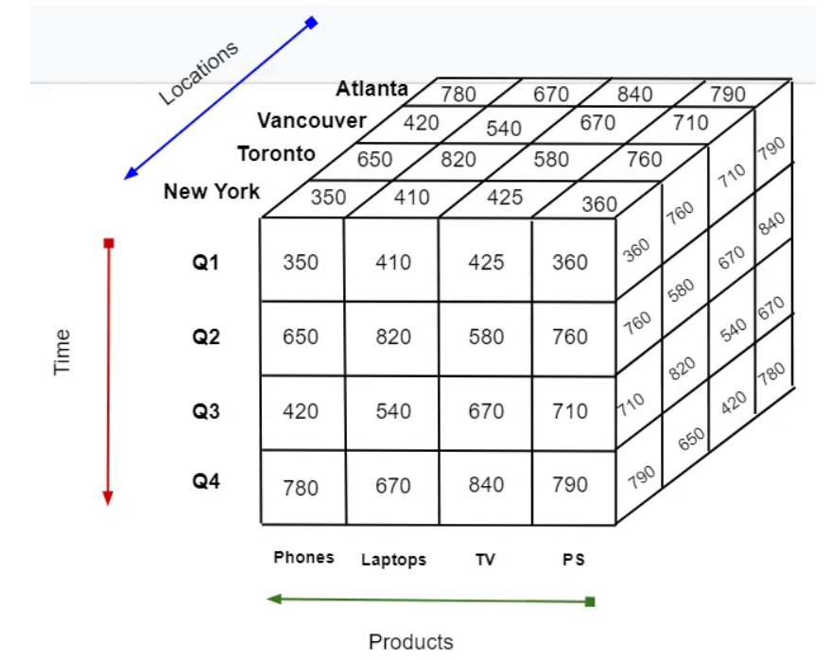
OLAP Intro.
Cube

Slide 12
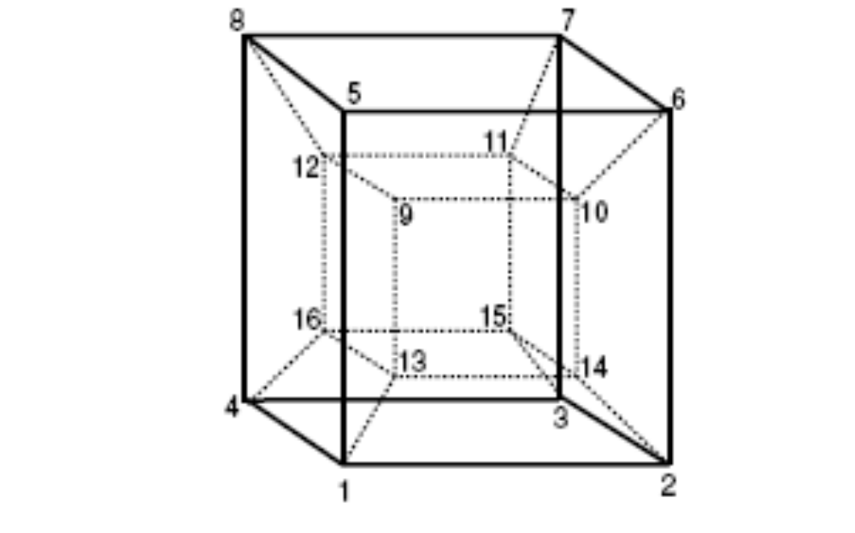
Beyond three dimensions
If we have more than three dimensions
Hyper-cubes, is a cube with more than three dimensions

Slide 13
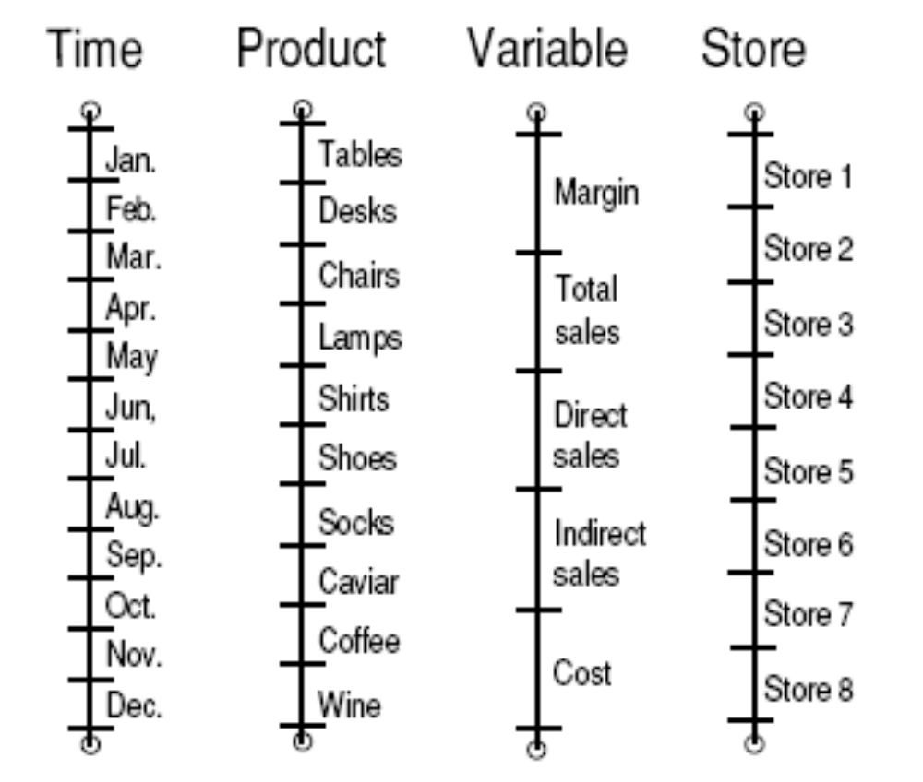
Another form for 4 dimensions
Four dimensions can be represented by four lines

Slide 14
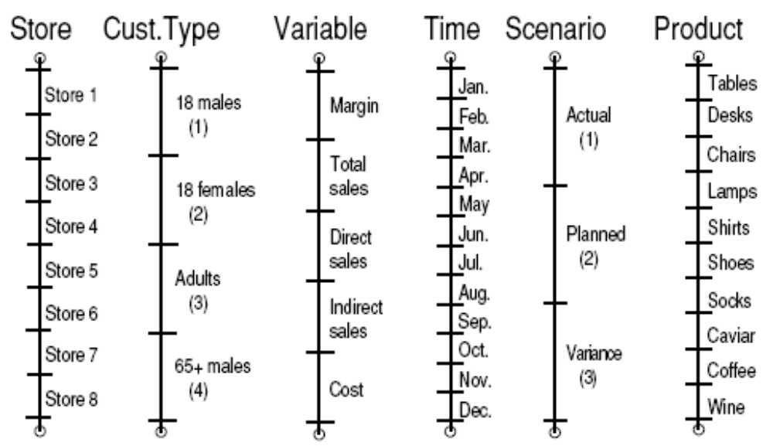
Hyper-cubes on computer screen
Six dimensions can be represented on computer screen

Slide 15
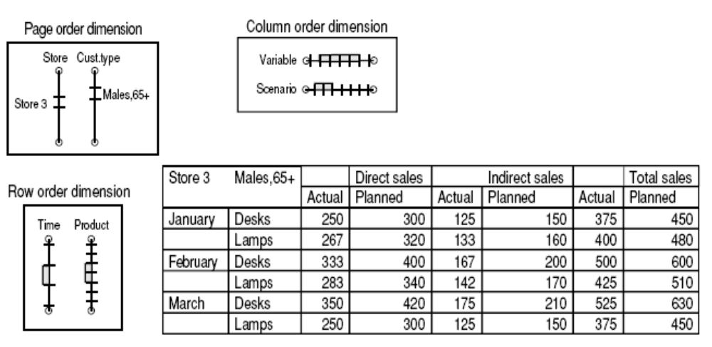
Diff. Six-dimension display

Slide 16
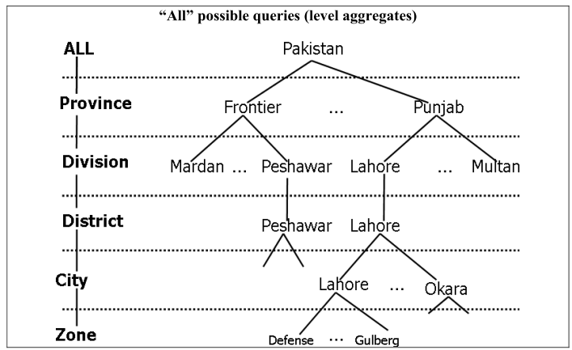
Levels in Dimension

Slide 17
Operations in OLAP

Slide 18
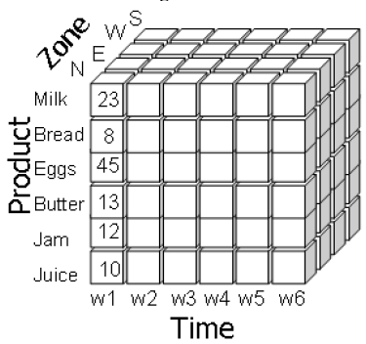
Cube Navigation Operations
Roll up
Drill down
Pivot
Slice
Dice

Slide 19
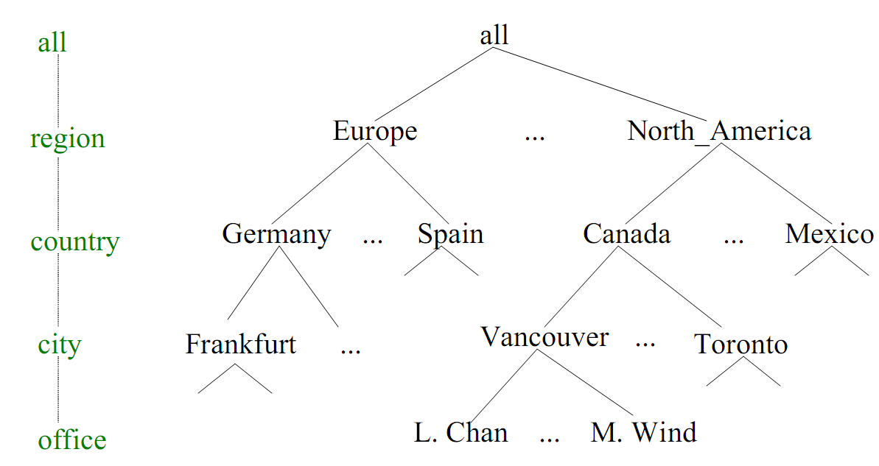
Navigation Operations: Roll-up
Roll Up
  Perform aggregation on a data cube, involves summarizing the data along one dimension
  Summarize data e.g. given sales

Slide 20
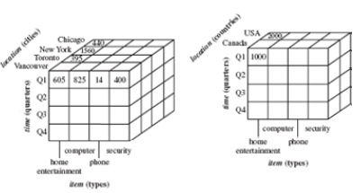
Navigation Operations: Roll-up

Slide 21
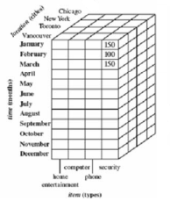
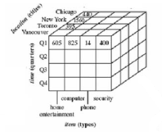
Navigation Operations: Drill-down
Drill down
  Get more details, find breakup of sales from Quarter to Months
  Allows users to navigate among levels of data ranging from the most summarized (up) the most detailed (down)

Slide 22
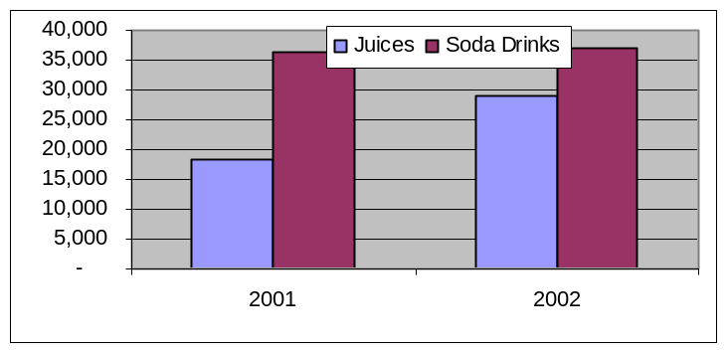
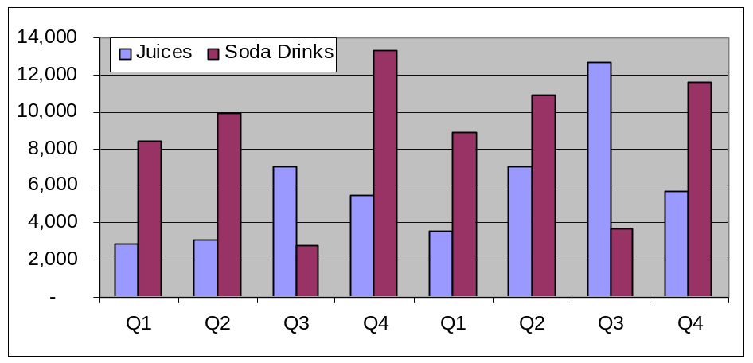
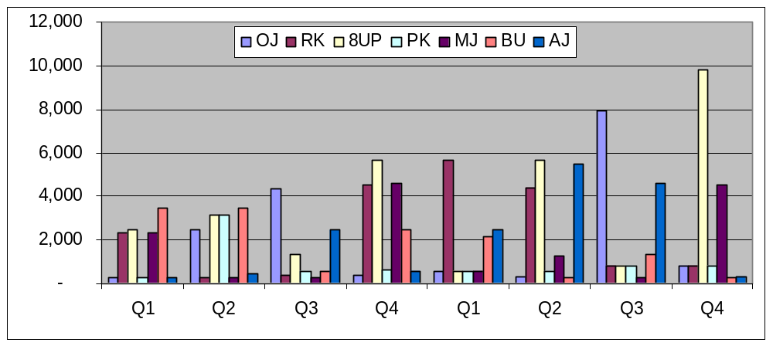
Graphical form
Drill-Down
Roll-Up
2001 2002
Drill-down
Ahsan Abdullah
2001 2002

Slide 23
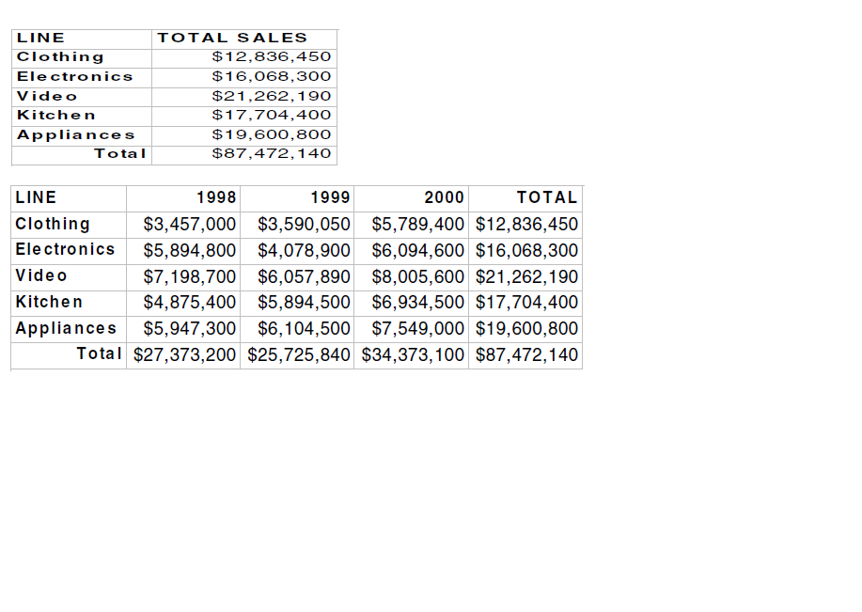
Navigation Operations: Drill-down
High level summary
by product line

Slide 24
Navigation Operations: Drill-down
High level summary
by product line
Drill down
by year

Slide 25
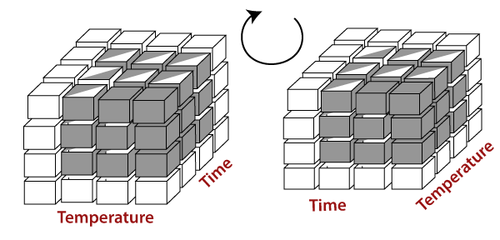
Navigation Operations: Pivot
Pivot operation is also called rotation
Rotates the data axes in view to provide alternative presentation

Slide 26
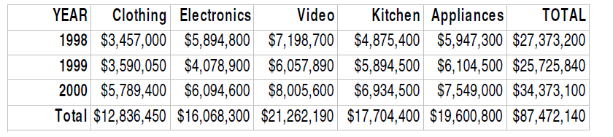
Navigation Operations: Pivot
Rotate columns
to rows

Slide 27
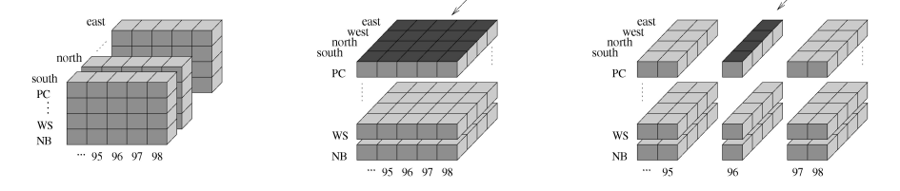
Navigation Operations: Slice
Slice Operation
  Correspond to reducing the number of dimensions by taking a project of data in cube on a dimension
  Slice operation will reduce the number of dimensions

Slide 28
Navigation Operations: Slice

Slide 29
Navigation Operations: Dice
Dice Operation
  Produces a sub-cube based on specific values of multiple dimensions (two or more dimensions)
  Select data that satisfies a list of predicates connected by logical operators AND, OR, or NOT

Slide 30
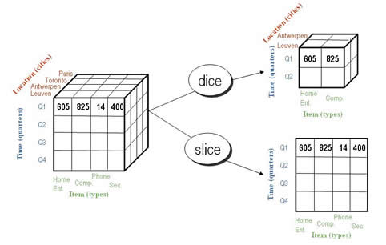
Navigation Operations: Slice vs. Dice
Slice performs a selection on one dimension of a cube
Dice operation defines a sub-cube by performance a selection on tow or more dimensions

Slide 31
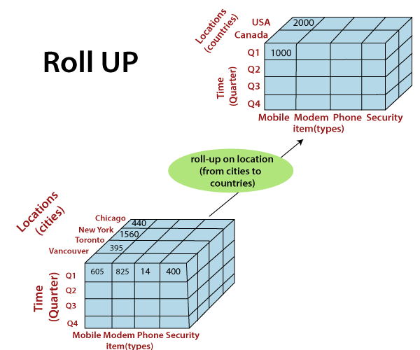

Slide 32
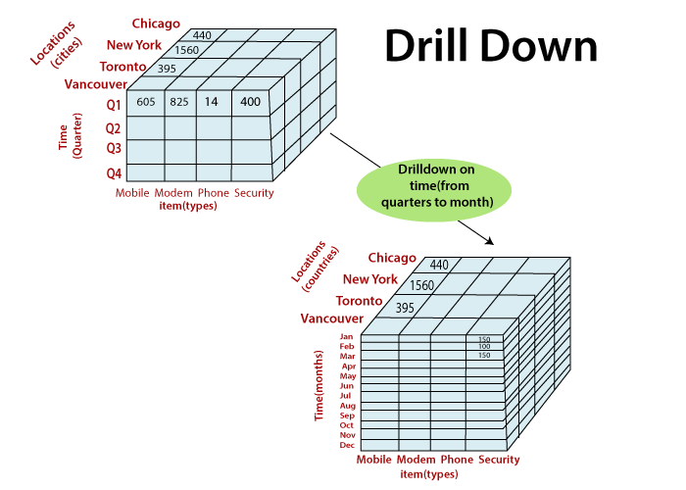

Slide 33
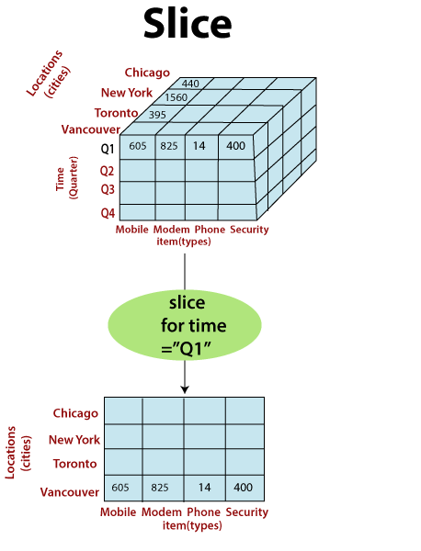

Slide 34
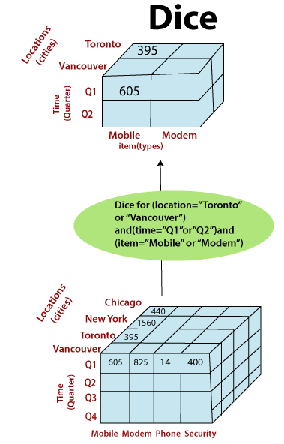

Slide 35
Sample Cube (visualization)
Sales
Sales
Count
Count
Sales
Count
+ Washington
+ Washington
- Washington
$2520
$2520
+ Bellingham
120
120
$700
32
+ California
+ Bremerton
$400
20
$2410
129
+ Olympia
$850
44
+ Redmond
$250
9
+ Seattle
$320
15
+ California
- California
$2410
+ Berkeley
129
$820
41
+ Beverly Hills
$910
50
+ Los Angeles
$680
38

Slide 36
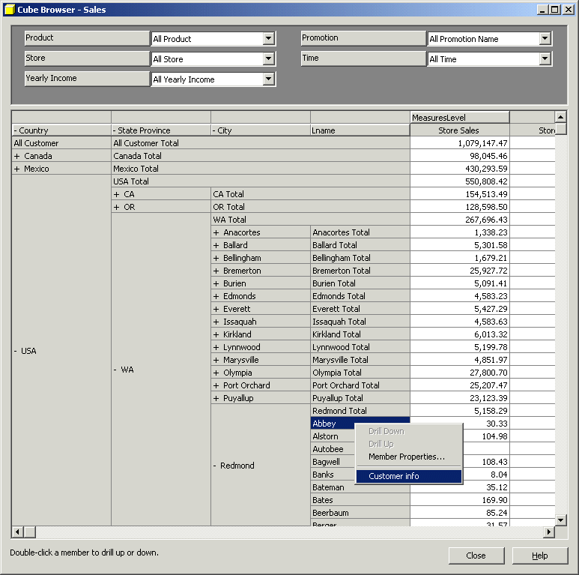
Sample Cube

Slide 37
Northwind Example
OLAP Operations

Slide 39
Implementation of OLAP

Slide 40
OLAP Implementation Architectures
MOLAP
ROLAP
HOLAP

Slide 41
OLAP Implementation
MOLAP: OLAP implemented with a multi-dimensional data structure.
ROLAP: OLAP implemented with a relational database.
HOLAP: OLAP implemented as a hybrid of MOLAP and ROLAP.

Slide 42
OLAP Implementation: MOLAP
Data is stored in the form of multi-dimensional arrays (cubes).
Analytical tools to allow analysis of data
It requires the pre-computation and storage of information in cube

Slide 43
OLAP Implementation: MOLAP
Advantages
  Instance response (pre-calculated aggregates)
  Excellent performance
Disadvantages
  Limited in the amount of data it can handle
  Long load time (due to pre-calculation)
  Very sparse cube (space wastage) for high cardinality
  Actually, the cubes are less than 1% full

Slide 44
Data Sparsity and Dense Value
The term sparsity has been used for missing, inapplicable, zero value
Notice all sparse or blank cell
  Identification of sparse or blank cell is very important
  Very sparce cube (wastage of space)
Opposite value is DENSE value
Some values are meaningless (Identify them)
Need to distinguish missing & meaningless value

Slide 45
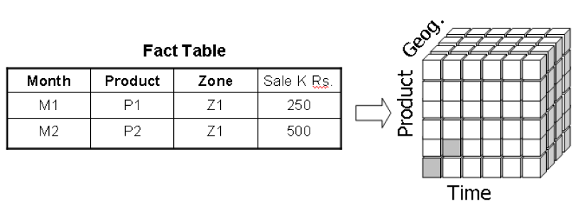
Data Sparsity and Dense Value

Slide 46
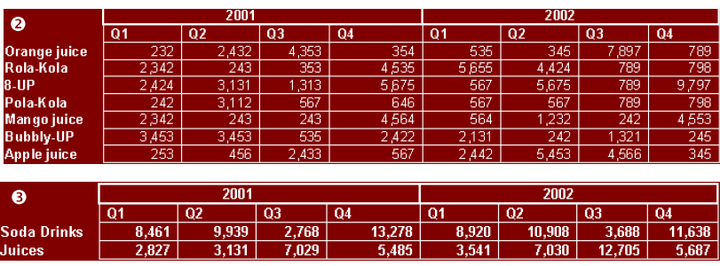
OLAP Implementation: ROLAP
Data is stored as relational tables
ROLAP and space requirements
  Increase in number of dimensions increases number of summary tables
  Consider two dimensions
    Time: Day, Week, Month, Quarter, Year, All days
    Product: Item, subcategory, Category, all products

Slide 47
ROLAP as a “Cube”
OLAP data is stored in a relational database (e.g. a star schema)
The fact table is a way of visualizing as a “un-rolled” cube.
So where is the cube?
  It’s a matter of perception
Geog.
Fact Table
Month
Product
Zone
Sale K Rs.
M1
P1
Z1
250
Product
M2
P2
Z1
500
Time

Slide 48
OLAP Implementation: ROLAP
Advantages
  Can handle large amount of data
  Can leverage functionalities inherent in the relational DB
Disadvantages
  Performance can be slow
  Limited by SQL functionalities

Slide 49
OLAP Implementation: HOLAP
Hybrid OLAP
Target is to get the best of both worlds
HOLAP allow co-existence of pre-build MOLAP cubes alongside relational OLAP or ROLAP structure

Slide 50
OLAP Implementation: Summary
Multidimensional OLAP (MOLAP)
  Best Query Performance
Relational OLAP (ROLAP)
  Ideal for large databases
Hybrid OLAP (HOLAP)
  Best & Worst of both worlds!

